Slide 1
Lab Lecture 10
CC: Ms. Shiza Riaz Memon

Slide 2
DES (Data Encryption Standard)
The Data Encryption Standard (DES) is a symmetric-key block cipher published by the National Institute of Standards and Technology (NIST).
DES is an implementation of a Feistel Cipher.
It uses 16 round Feistel structure.
The block size is 64-bit.
Though, key length is 64-bit, DES has an effective key length of 56 bits, since 8 of the 64 bits of the key are not used by the encryption algorithm. These 8 bits are parity bits used for function check only

Slide 3
Components of DES
Round function
Key schedule
Initial and final permutation

Slide 4
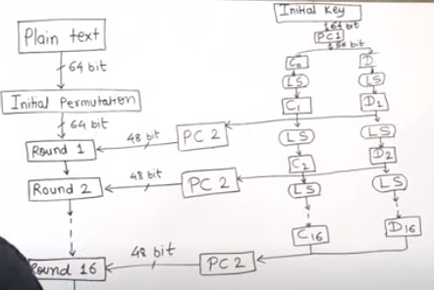

Workflow

Slide 5
DES
Steps to perform DES:
Plain text of 64 bit goes through initial permutation.
Initial Permutation is nothing but rearranging of the bits of Plain Text.
The initial key of 64 bits is compacted into 56 bits as 8 bits are for parity
A parity bit is a check bit, which is added to a block of data for error detection purposes.
It is used to validate the integrity of the data.
The value of the parity bit is assigned either 0 or 1 that makes the number of 1s in the message block either even or odd depending upon the type of parity.
Parity check is suitable for single bit error detection only.

Slide 6
DES
The 56 bits are then passed through PC1 (Permuted Choice 1)
The 56 bits are then divided into two halves of 28 bits each.
Left circular Shift is applied to these bits.
The LCS depends upon the round number
For round 1,2,9,16 only 1 bit is shifted.
For all other rounds 2 bits are shifted.
The output is then again passed to Permuted Choice 2 and 48 output bits for key are sent into the round.
For each round key would be different.

Slide 7
DES
After 16 rounds are completed, the output goes for final permutation.
Final permutation is inverse initial permutation.
We follow rearranging or transposition order in these permutations.
After final permutation the 64 bit output is our cipher text.

Slide 8
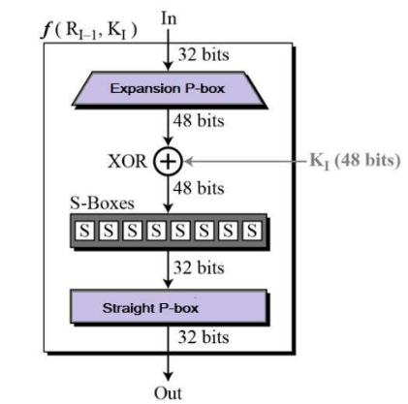
Rounds of DES

Slide 9
Round Function
In round function the 64 bits are divided into 32 bits each left and right.
Now, one side at a time, the 32 bits go through expansion permutation to become 48 bits.
The 48 bits from the message and 48 bits of the key are combine and the XOR Operation is being performed on them.
The output of XOR is then given to Substitution box or S-box.

Slide 10
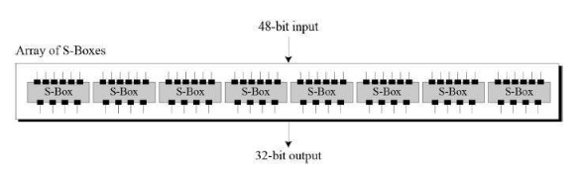
S-boxes
The S-boxes carry out the real mixing (confusion). DES uses 8 S-boxes, each with a 6-bit input and a 4-bit output.

Slide 11
S-boxes
The 2 extreme bits out of 6 bits are taken for rows and remaining middle 4 bits for columns.
Total combination that 2 bits can make =4
Total combination that 4 bits can make =16
This means that we have 4 rows and 16 columns

Slide 12
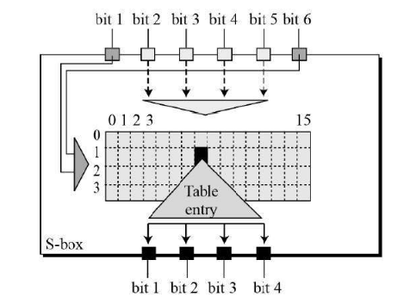
S-boxes

Slide 13
S-boxes
Now if we have 6 bits as 100000
The extreme bits represent 10=2
And the middle bits 0000 represent =0
The intersection of row 2 and column 0 will give us a value and that value would be represented as a 4 bit value.
We have 8 S-boxes in total
4*8= 32 bits.
That’s how 32 bits output is generated from Substitution boxes.

Slide 14
DES
After that the 32 bits are then again transposed through permutation.
The permuted 32 bits and bits from the left parsed data (32 bits) are added to XOR. Now the after XOR operation this becomes our final output of right side for round 1
Final output of left side for round 1 would be the initial 32 bits that were given to right side
The output for round 1 is actually the input for round 2 and so on.
Once you reach round 16 the left and right values are swapped, final permutation is Performed and then you get your final output as cipher text

Slide 15
Electronic Code Book
Electronic code book is the easiest block cipher mode of functioning.
It is easier because of direct encryption of each block of input plaintext and output is in form of blocks of encrypted cipher text.
Generally, if a message is larger than b bits in size, it can be broken down into a bunch of blocks and the procedure is repeated.

Slide 16
Cipher Block Chaining
Cipher block chaining or CBC is an advancement made on ECB since ECB compromises some security requirements.
In CBC, the previous cipher block is given as input to the next encryption algorithm after XOR with the original plaintext block.
In a nutshell here, a cipher block is produced by encrypting an XOR output of the previous cipher block and present plaintext block.

